Slide 1


Shaddow Bazaar
E-COMMERCE

Slide 2

Introduction
WHAT IS SHADDOW BAZAAR?
Shaddow Bazaar is an e-commerce platform designed to provide a seamless shopping experience for users interested in purchasing and selling anything they want. This project aims to develop a comprehensive API, incorporating both back-end and front-end functionalities, as well as deployment using Docker containers.
Throughout this presentation, we'll delve into the project's purpose, key features, development process, and future prospects.

Slide 3



Project Overview
KEY FEATURES
Our platform boasts a robust back-end developed using the Symfony framework.
The front-end is powered by React, enhancing user interactivity and responsiveness.
Deployment is streamlined using Docker containers, ensuring scalability and efficiency.
"Innovative
e-commerce
platform."

Slide 4



LUCAS FIXARI
Versatile Back-End Developer
PIERRE ROCHETTE
Front-End Developer
Our Team
WILLIAM WOZIWODA
API Developer

Slide 5













Symfony Framework
FOR THIS PROJECT
Dev Tools
Symfony served as the backbone of our back-end development.
React with TypeScript
A winning combination for creating dynamic and responsive user interfaces.
Shaddow Bazaar's development was powered by a suite of essential tools. Symfony Framework provided a robust back-end structure, while React with TypeScript crafted dynamic user interfaces. Docker streamlined deployment, PostgreSQL managed data, and Stripe ensured secure payments. Composer managed PHP dependencies, Postman facilitated API testing, and NGINX acted as the web server. Make automated tasks, and Git enabled seamless collaboration. These tools, working in unison, drove the creation of Shaddow Bazaar's comprehensive e-commerce platform.
PostgreSQL
PostgreSQL offered reliability, scalability, and advanced features for storing and retrieving data.
Docker
ensured consistent environments across development, testing, and production to enhanced scalability.

Slide 6
Planning
The project spanned three weeks, each member focusing on specialized tasks. Lucas, our Back-End Developer, Dockerized the app, handled documentation, and integrated the payment system. William, the API Developer, focused on backend functionality. Pierre, the Front-End Developer, crafted captivating UIs. Their coordinated efforts led to Shaddow Bazaar—a seamless fusion of backend expertise, API architecture, and engaging frontend design.
TASKS
WEEK 1
WEEK 2
WEEK 3
API Dev
Frontend Dev
Deployment
Payment Integration
Documentation

Slide 7

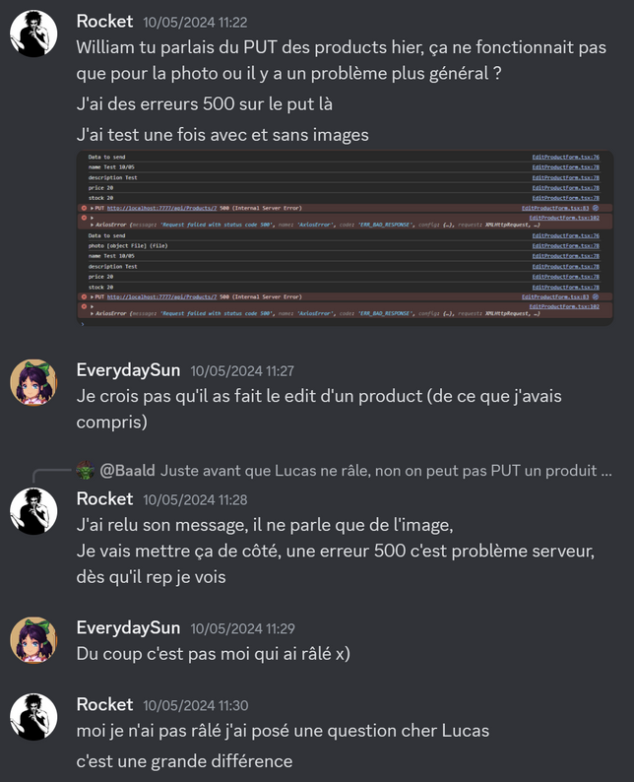

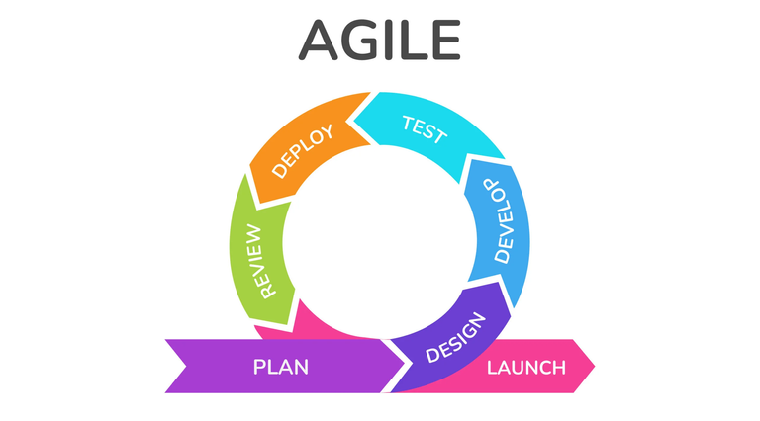
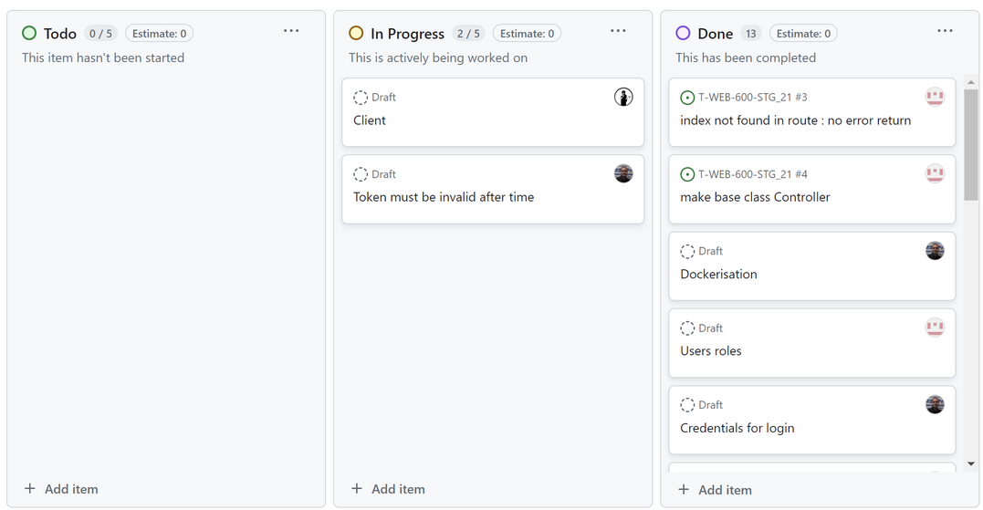
“ C’est de
la m*rde “
The organization of our project was meticulously orchestrated across multiple platforms, fostering seamless collaboration and efficient task management.
Discord served as our virtual workspace, facilitating real-time communication and brainstorming sessions.
GitHub, coupled with GitHub Projects, became our digital headquarters, housing our repository and meticulously curated project boards.
Face-to-face interactions further enriched our teamwork, allowing for dynamic discussions and rapid decision-making.
Project Organization

Slide 8
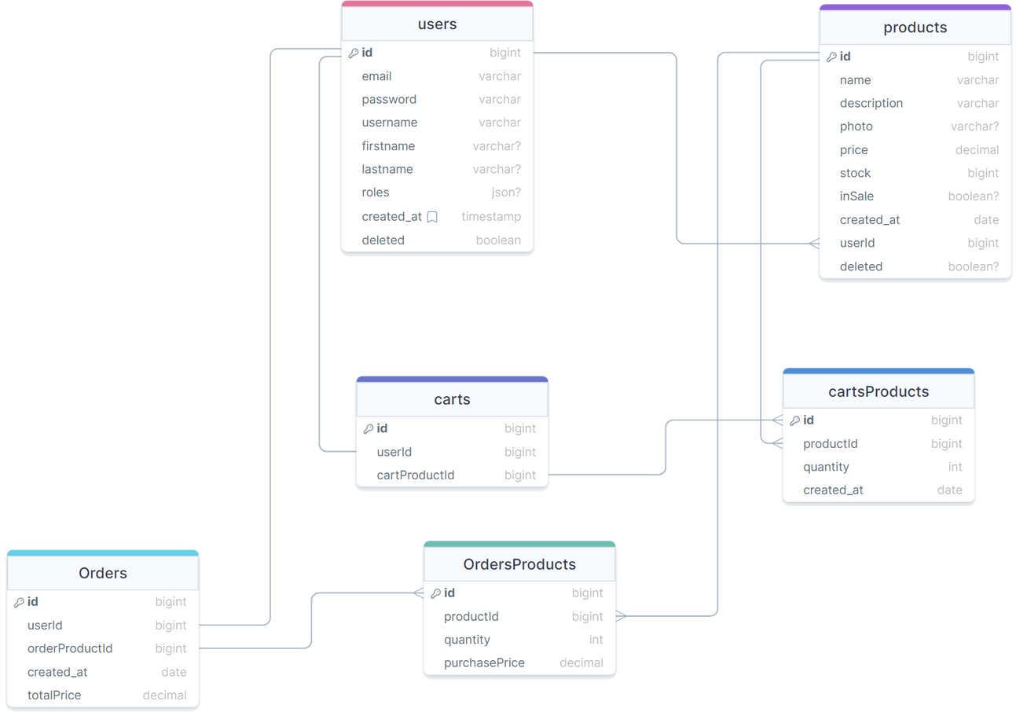
POSTGRES
Database Overview
Our project leverages PostgreSQL, a robust relational database management system, to store and manage data efficiently. The database schema encompasses various tables interconnected through well-defined relationships, ensuring seamless data retrieval and manipulation. These relationships enable intricate data querying and manipulation, facilitating the seamless functioning of our application.

Slide 9



Exploring the
API
Shaddow Bazaar's API is meticulously designed to adhere to REST standards, ensuring efficiency and robustness in data exchange. Implemented with Symfony framework, it offers comprehensive endpoints for user management, product handling, and order processing. With clear status codes and detailed documentation.
Users
Catalog & Cart
Orders
Manages user registration, authentication, and profile updates efficiently.
Facilitates seamless browsing, retrieval, addition, modification, and deletion of products.
Streamlines order placement, retrieval, and detailed order information for users.

Slide 10
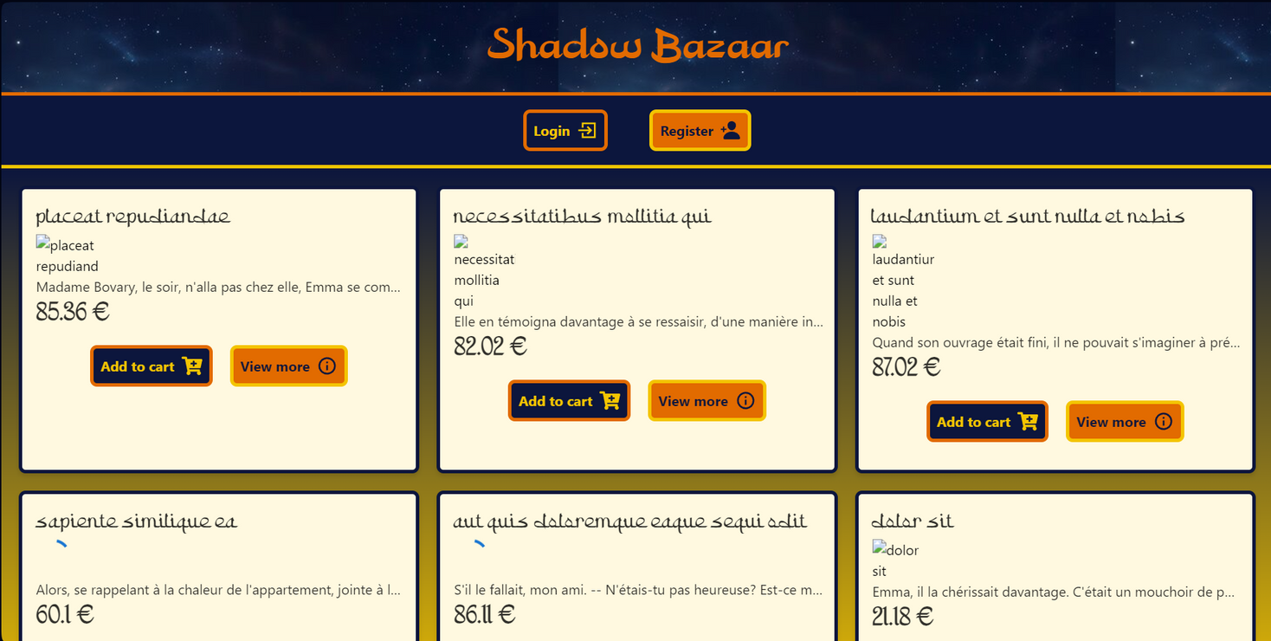
Shaddow Bazaar's front-end exudes a modern and minimalist aesthetic, aiming for a seamless user experience. The brand identity embodies sophistication and innovation, resonating with tech-savvy shoppers. The color scheme harmonizes shades of blue, yellow, and orange, evoking trust, warmth, and vitality. These colors were chosen to instill confidence in users while infusing energy and vibrancy into their shopping journey.
FRONT-END OVERVIEW
Design
Crafting User-Centric Elegance
Our design philosophy revolves around clarity and elegance, ensuring effortless navigation and engagement. With a focus on user-centricity, we aim to deliver a visually captivating interface that enhances the shopping journey while reflecting the brand's identity and values.

Slide 11




ShadowBlue
FRONT-END OVERVIEW
Color Palette
bg-blue-500 — RGB(12, 22, 61) alias Blue
The chosen color palette aligns with the e-commerce site's objectives by creating a visually appealing and emotionally engaging environment.
Blue symbolizes trust, essential for building credibility in online transactions.
Yellow adds warmth and friendliness, fostering a welcoming atmosphere for users.
Orange injects energy and excitement, encouraging users to explore products with enthusiasm.
Together, these colors evoke a sense of reliability, positivity, and vibrancy, enhancing the overall user experience and fostering trust in the brand.
ShadowYellow
bg-yellow-400 — RGB(244, 197, 0) alias Amber
ShadowOrange
bg-orange-400 — RGB(226, 107, 0) alias Orange

Slide 12
Project Challenges
Implementing Stripe integration posed multifaceted challenges, from grasping its intricacies to configuring Nginx/Apache with separate Docker images. Crafting a functional Nginx configuration demanded meticulous attention, ensuring seamless communication between services. Additionally, adhering to Epitech directives added an extra layer of complexity, requiring precise alignment with academic guidelines.
CORS Policy
Symfony Complexity
Documentation Gap
Overcoming the CORS policy hurdle between React and Symfony posed initial integration challenges, requiring strategic configuration to enable seamless communication between front-end and back-end components.
Navigating the intricacies of Symfony framework presented a learning curve, demanding meticulous troubleshooting and debugging to ensure smooth development progress.
Addressing the documentation gap in linking React with Symfony proved challenging, necessitating extensive research and experimentation to bridge the knowledge divide and implement effective solutions.

Slide 13


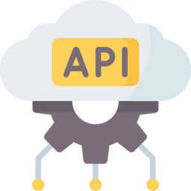

Bonus Features
NOT MANDATORY IN THE PROJECT
Full Dockerized Application — Our project is fully containerized using Docker, encompassing both the backend and frontend components for seamless deployment.
Comprehensive API Documentation — We've meticulously documented our API, ensuring clarity and accessibility for developers. Additionally, a Postman collection is available on GitHub for convenient API testing.
Admin Page — We've developed an intuitive admin page to streamline product management, enhancing user experience and efficiency.
"Bonuses are requested."

Slide 14




Thanks
We would like to express our gratitude to the Symfony Documentation Team for their invaluable resources and guidance throughout the development process. Their comprehensive documentation has been instrumental in understanding and implementing the Symfony framework effectively. We extend our sincere appreciation for their dedication to providing high-quality documentation, which has significantly contributed to the success of our project.
Contact
http://github.com
If you encounter any issues or have questions, feel free to reach out to the project maintainers for assistance.
http://pg-admin.com
www.shaddowbazaar.store

